Slide 1
DEVELOPMENT OF A CUSTOMISED TRAVEL RECOMMENDATION SYSTEM WITH RECENCY EFFECTS

Slide 2
ABSTRACT:-
A travel recommendation system based on social media activity provides a customized place of interest to accommodate user-specific needs and preferences. In general, the user’s inclination towards travel destinations is subject to change over time. In this project, we have analyzed users’ twitter data, as well as their friends and followers in a timely fashion to understand recent travel interest. A machine learning classifier identifies tweets relevant to travel. The travel tweets are then used to obtain personalized travel recommendations. Unlike most of the personalized recommendation systems, our proposed model takes into account a user’s most recent interest by incorporating time-sensitive recency weight into the model. Our proposed model has outperformed the existing personalized place of interest recommendation model, and the overall accuracy is 75.23%.

Slide 3
EXSISTING SYSTEM | PROPOSED SYSTEM
In all existing states of art recommendation system filtering techniques, collaborative filtering (CF) and content-based filtering (CBF) are most trendy in terms of generating mainstream recommendations as well as moderately treating a cold start for a brand-new user.. In CF, the recommendations are made based on user similarity on previous preference and CBF discretizes the matching attributes of a selected item. The closer the similarity, the higher the likelihood of the items to be recommended by these basic filtering techniques. The effectiveness of these contemporary recommendation techniques is evaluated based on the prediction accuracy. | In this paper, we endeavor to provide personalized travel recommendation (PTR) using social media (twitter profile) information of an individual to obtain travel relevant tweet attributes such as URL count, number of hash tags, number of users mentions, the emotion of emoticons, number of media attachments (photos/video), length of tweets, and followers and friends’ preferences to provide user-oriented recommendation. In particular, our PTR system is modeled with users’ social profile based collaborative filtering with augmented user profile matrix and comprehends recency effect to ensure the more appropriate and recent choice of POI. A prototype system for this model has been developed and evaluated.
EXISTINGALGORITHM:- Collaborative Filtering (CF) | PROPOSED ALGORITHM:- Personalized Travel Recommendation (PTR)

Slide 4
ALGORITHM DEFINITION:- | ALGORITHM DEFINITION:-
To address some of the limitations of content-based filtering, collaborative filtering uses similarities between users and items simultaneously to provide recommendations. This allows for serendipitous recommendations; that is, collaborative filtering models can recommend an item to user A based on the interests of a similar user B. Furthermore, the embeddings can be learned automatically, without relying on hand-engineering of features. | PTR system is modeled with users’ social profile based collaborative filtering with augmented user profile matrix and comprehends recency effect to ensure the more appropriate and recent choice of POI. A prototype system for this model has been developed and evaluated. Social media analysis for personalization of travel recommendations. Travel tweet classifier using machine learning and diversified list of recommended places based on predicted scores. Incorporating the recency effect of social media for relevance and freshness on the POI recommendation.

Slide 5
DRAWBACKS:- | ADVANTAGES:-
Incapability of handling customers’ heterogeneous demands that require a bundle of different types of servers, Missing the truth-fullness property Requiring prohibitive computation for winner and payment determination. Susceptibility to the delayed entrance issue. | Uniform distribution Better price matching process Proving transparency

Slide 6
MINIMUMSYSTEM REQUIREMENTS
HARDWARE REQUIREMENTS
PROCESSOR : DUAL CORE 2 DUO.
RAM : 2GB DD RAM
HARD DISK : 250 GB
SOFTWARE REQUIREMENTS
FRONT END : J2EE (JSP, SERVLET)
BACK END : MY SQL 5.5
OPERATING SYSTEM : WINDOWS 7
IDE : ECLIPSE

Slide 7
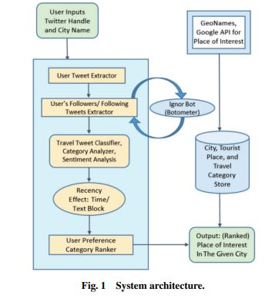
System Architecture

